Slide 1
1.3 Time series data and applications
Dr. Pim Ouwehand
October 2026

Slide 2
Overview
What is a time series?
Time series components and properties
Economic relations between series

Slide 3
Time series decomposition &
Time series components

Slide 4
Time series modelling
Assumption: time series can be decomposed into components
  Trend (long term movement)
  Cycle (business cycle, without fixed frequency)
  Seasonal
  Working days
  Outlier
  Structural breaks
  …
  Noise / irregular
Assumption: model specification is still valid in the future

Slide 5
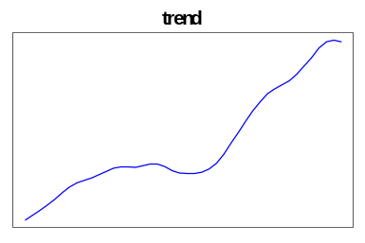
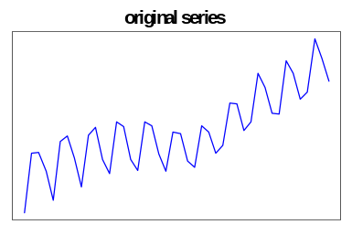
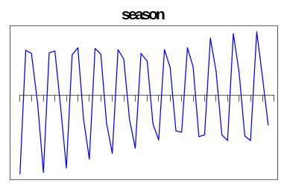
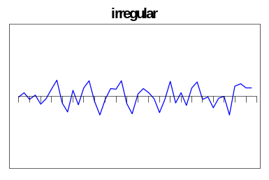
Time series decomposition (example)
trend/trendcycle

Slide 6
Additive decomposition
Y_{t} = TC_{t} + S_{t} + I_{t}
Seasonal fluctuations (S_{t}) are constant
11
9
7
Y
5
3
1
-1
0
20
40
60
80
100

Slide 7
Multiplicative decomposition
Y_{t} = TC_{t} * S_{t} * I_{t}
Seasonal fluctuations (S_{t}) increase with the level
Log-additive: log(Y_{t}) = log(TC_{t}) + log(S_{t}) + log(I_{t})
12
10
8
Y
6
4
2
0
0
20
40
60
80
100

Slide 8
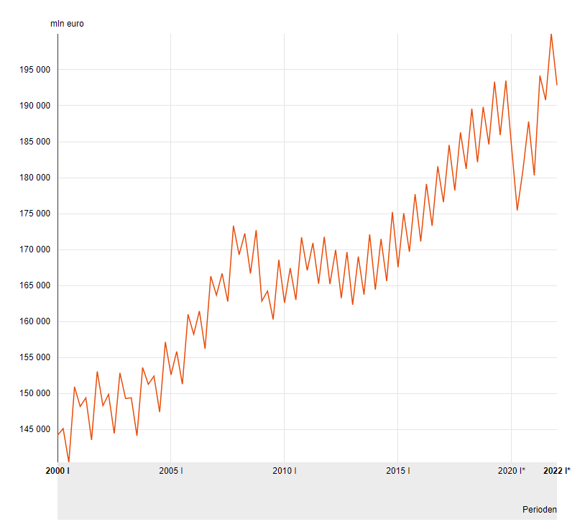
Additive or multiplicative?

Slide 9
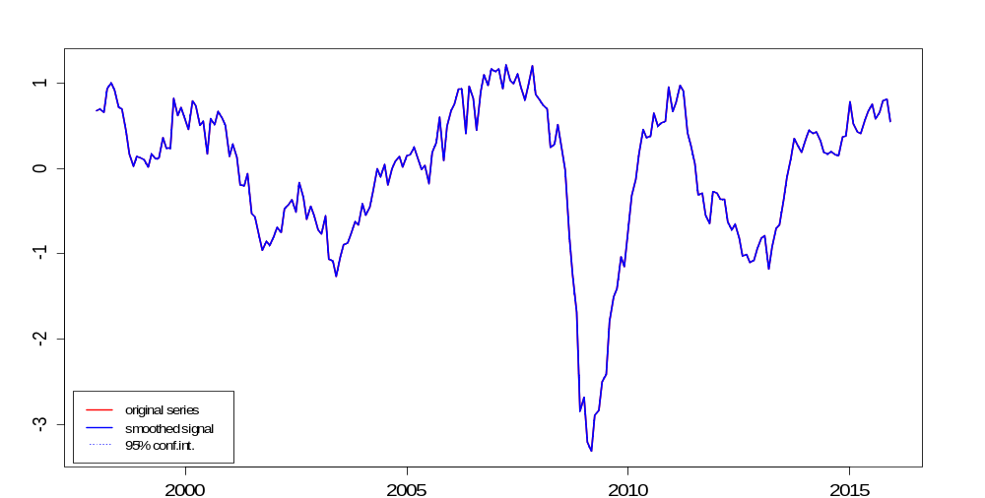
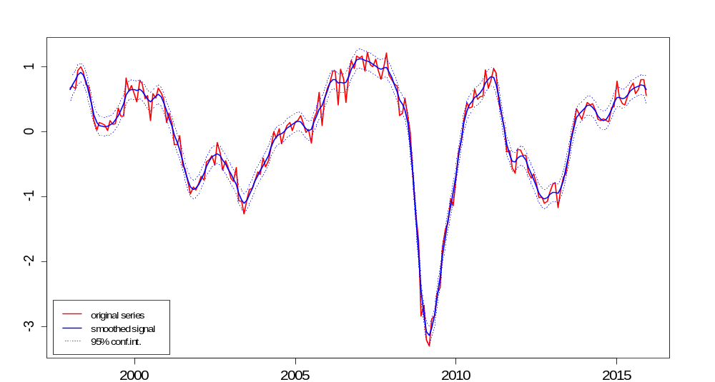
Properties of time series models
Revisions
End point problems
Overfitting
Nr. of observations

Slide 10
Time series components

Slide 11
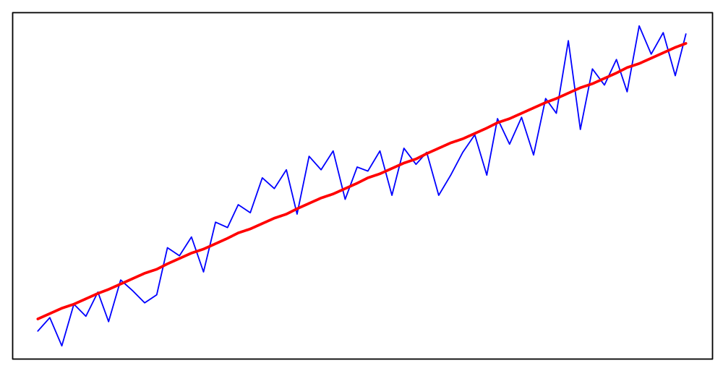
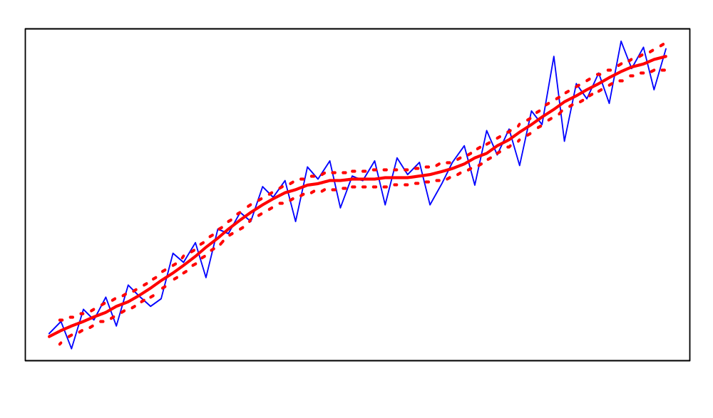
What is a trend?
Underlying long term growth rate
Global Local (with margins)

Slide 12
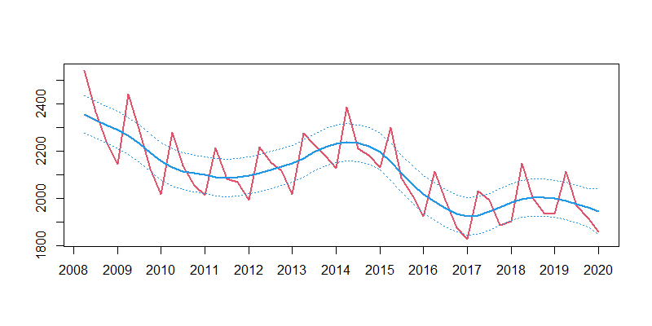
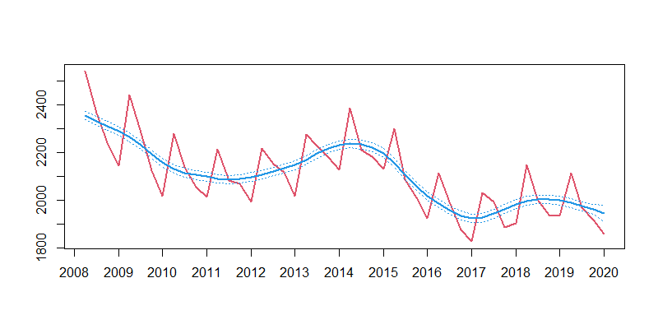
Trends and margins
Which plot shows
the correct
95%-margin?

Slide 13
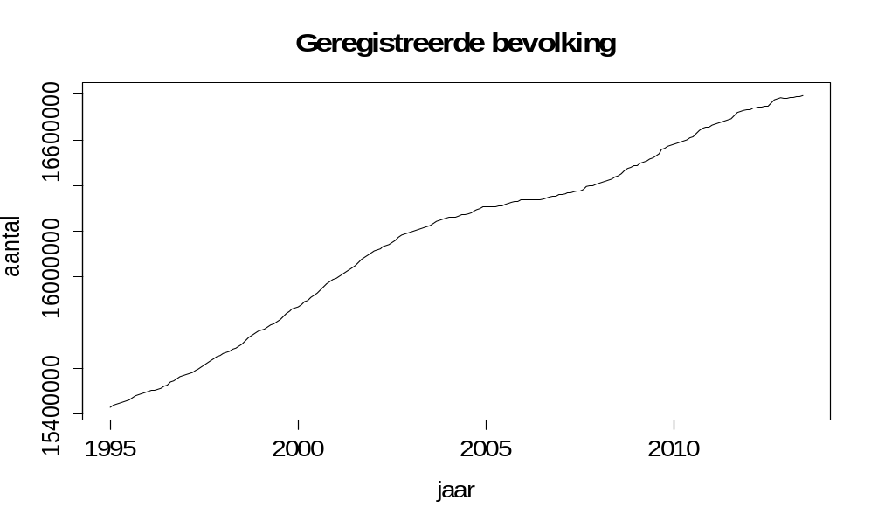
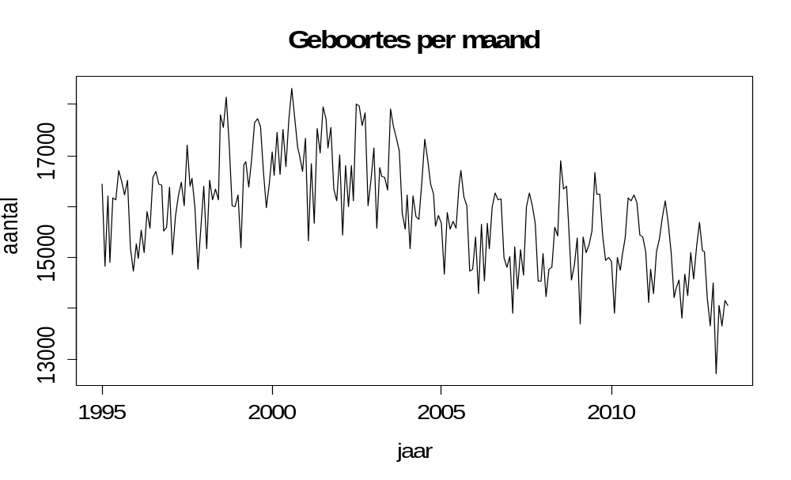
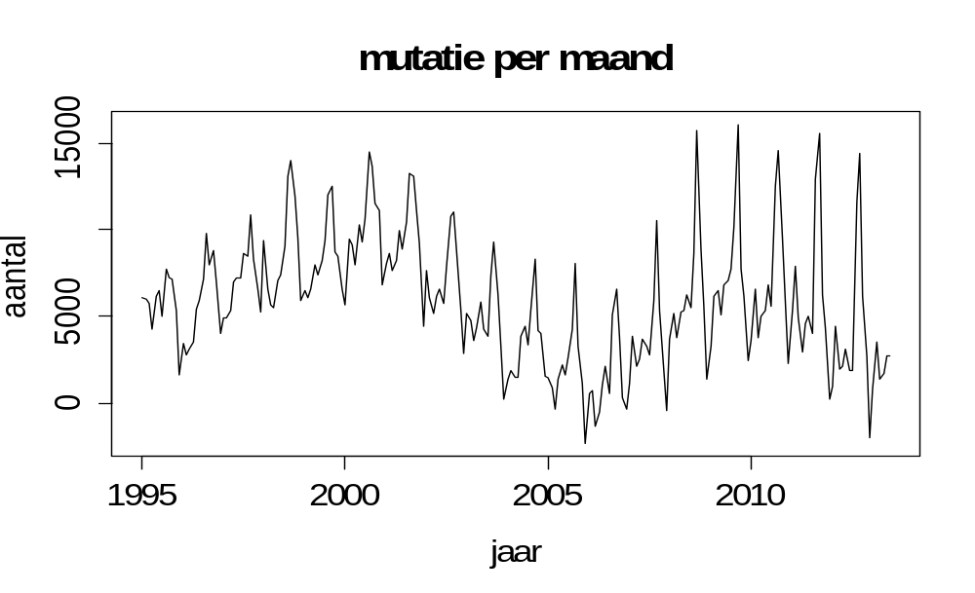
Seasonal patterns
up- and downward movements that repeat with a fixed (e.g. annual) frequency
…do not necessarily follow … are not always clearly visible
meteorological seasons
Registered population
Births per month
Change per month

Slide 14
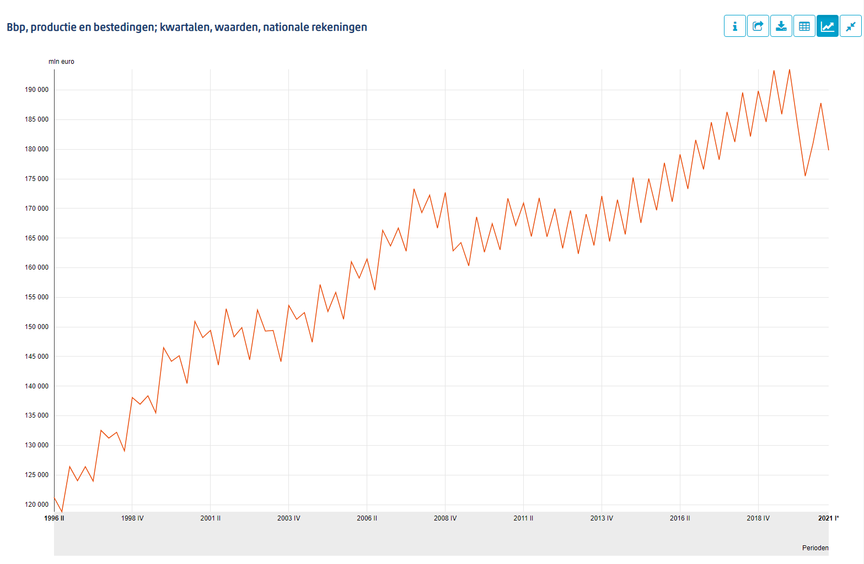
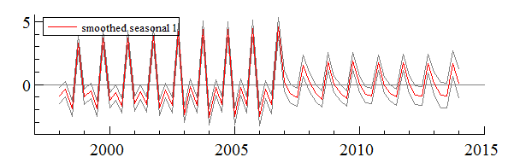
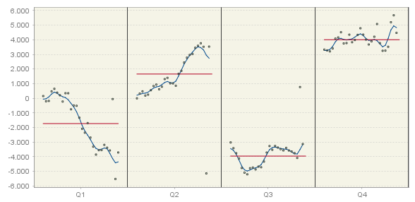
Seasonal pattern may change..
GDP
..suddenly, or….
…more gradually

Slide 15
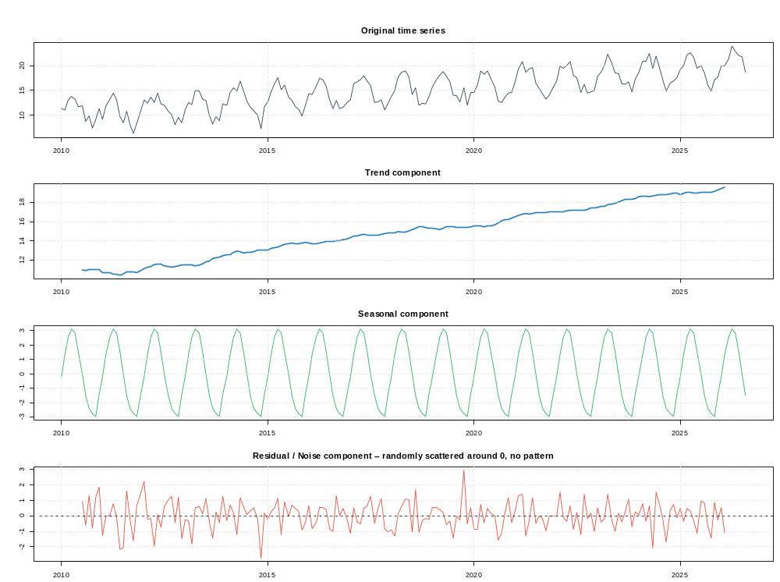
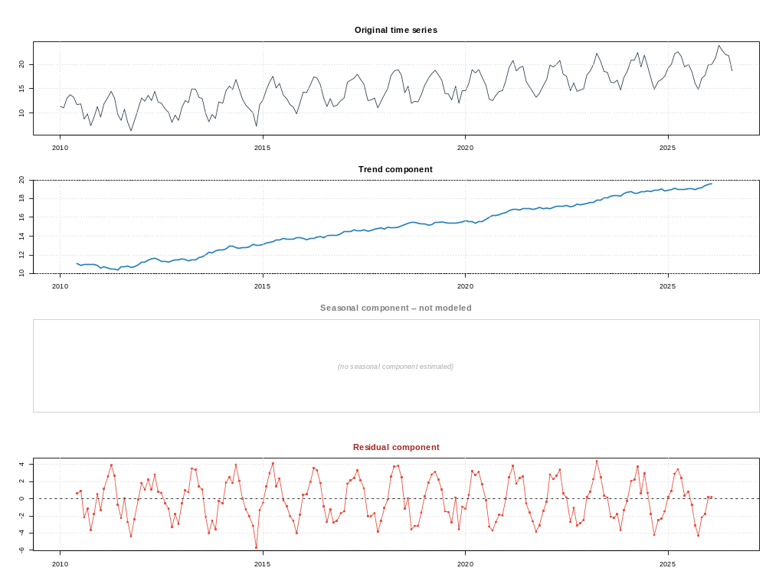
The irregular component
‘Noise’, should have not remaing pattern
Decomposition with seasonal without seasonal

Slide 16
Outliers and breaks
Observation whose value is unusually high or low compared with what the series’ typical behavior would predict.
-> Has a large residual error to a fitted model
-> Has to be accounted for in the model, in order to achieve a good fit.

Slide 17
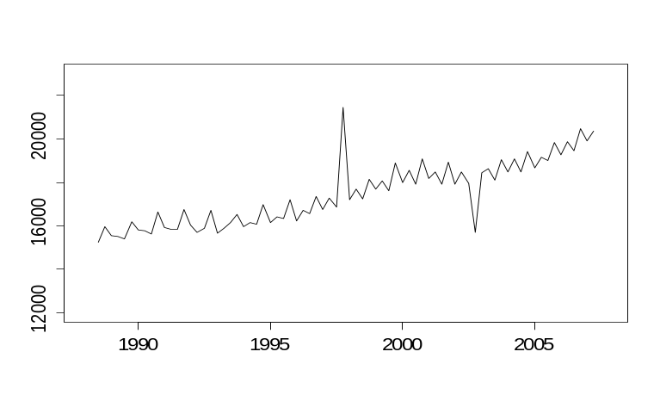
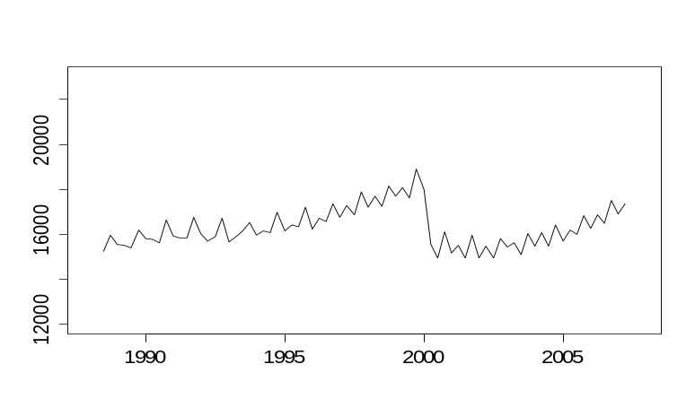
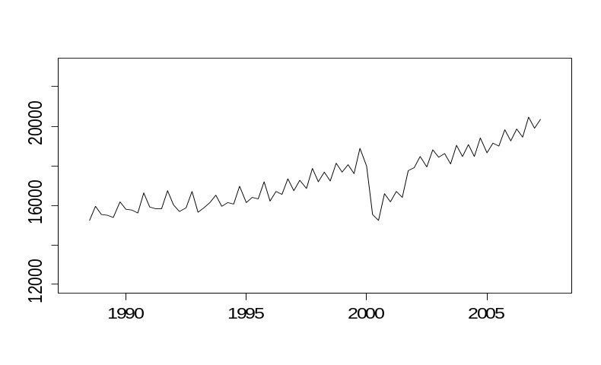
Outliers and breaks
Examples of
real world impacts
Change in tax reporting
Impact of COVID-19
Change in coverage
One-off impact, e.g. weather related
Additive outlier Level shift
Transitory change Seasonal break Ramp
0 1

Slide 18
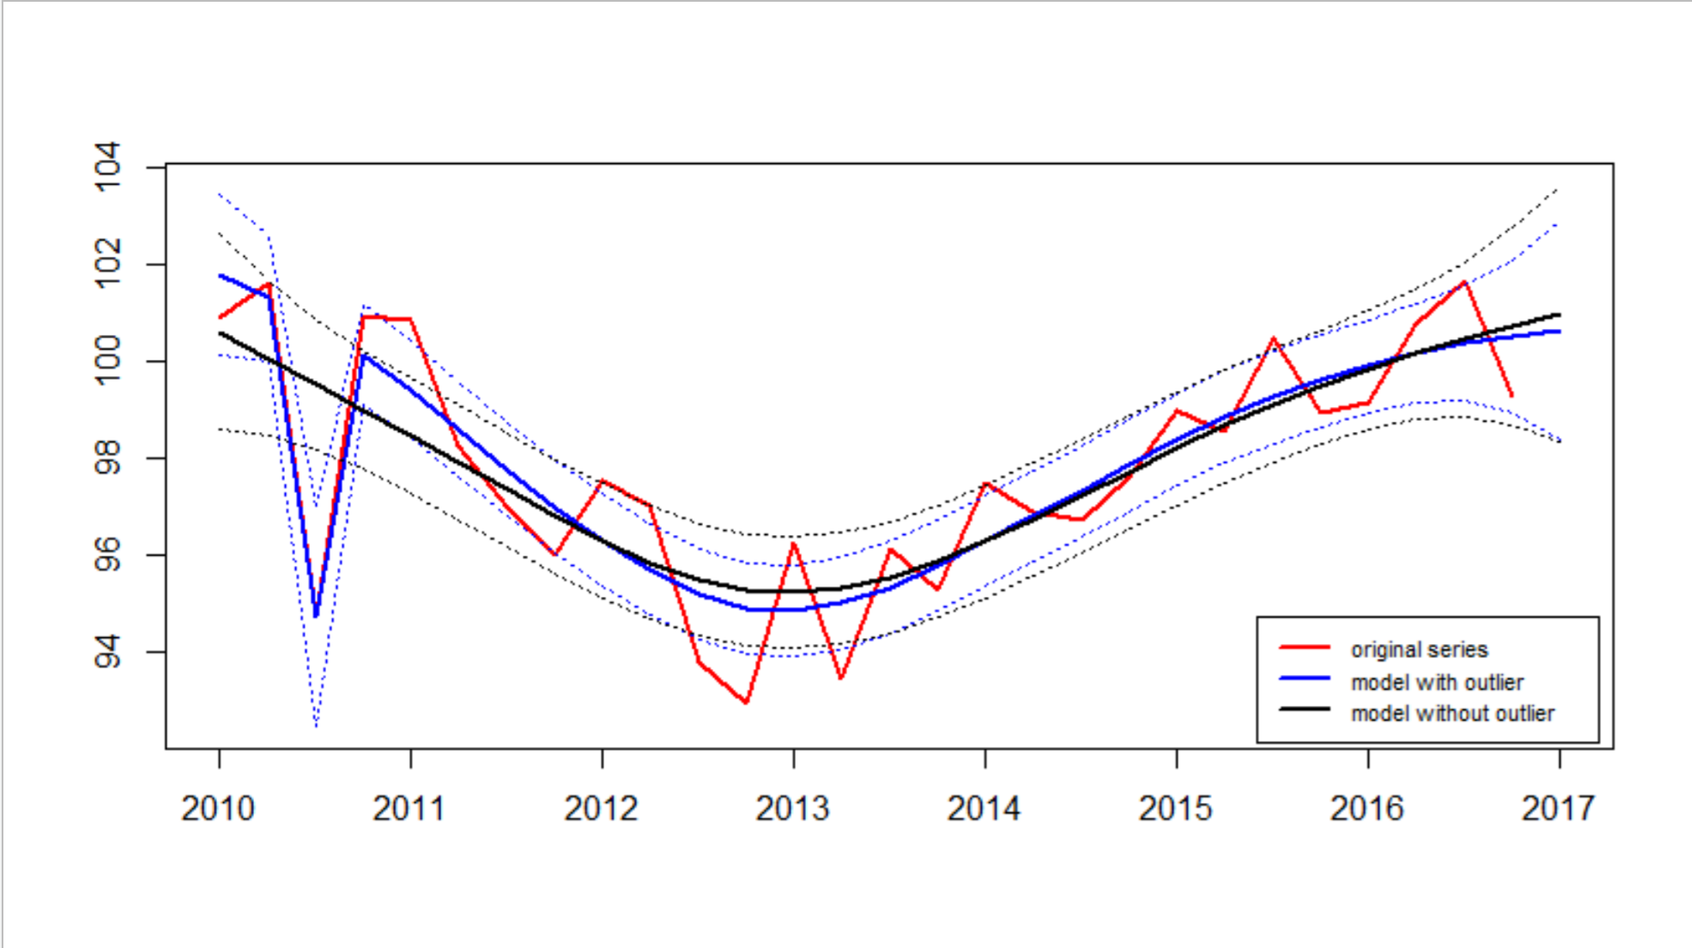
Additive outlier

Slide 19
Example regressor creation
Level shift
Additive outlier
$$δ_{j,t}^{}=\left\{\begin{matrix}1 & for every period ≥t from the period in which the break occurs. \\ 0 & for all other periods \end{matrix}\right.$$
$$δ_{j,t}^{}=\left\{\begin{matrix}1 & for the period in which the outlier occurs \\ 0 & for all other periods \end{matrix}\right.$$

Slide 20
Outliers
Period | Additive outlier | Level shift
2017 Q3 | 0 | 0
2017 Q4 | 0 | 0
2018 Q1 | 0 | 0
2018 Q2 | 0 | 1
2018 Q3 | 0 | 1
2018 Q4 | 1 | 1
2019 Q2 | 0 | 1
2019 Q2 | 0 | 1
2019 Q3 | 0 | 1
2019 Q4 | 0 | 1
2020 Q1 | 0 | 1
2020 Q2 | 0 | 1
2020 Q3 | 0 | 1
2020 Q4 | 0 | 1

Slide 21
How to identify outliers?
Prior knowledge
Visual inspection
Automatic detection X13: Addone
  For every period try every type of outlier (AO/TC/LS/SO)
  If highest t-value > critical value, add outlier
  Re-estimate model and repeat step 1 and 2 until no more outliers are found
  Backward deletion: remove least significant outliers one by one

Slide 22

Calendar effects
Working days
Trading days
National holiday (fixed vs. moving)
Leap year
Bridge days

Slide 23
Stationarity

Slide 24
Stationarity
Assumption for ARMA-models
A stationary time series is one whose statistical properties do not depend on the time at which the series is observed
-> time series with trends or seasonality are not stationary
More formal:
A stochastic process $X_{t}$ is (weakly) stationary if
  $E\left[X_{t}\right]=μ$for all t
  Var$\left[X_{t}\right]= σ^{2} \text{for} \text{all} \text{t}$ (homoscedasticity)
  Cov$\left[X_{t},X_{t+k}\right]=γ_{k}$ for all t (autocovariancefunction, acvf)
    $→$ autocorrelations ${ρ_{k}=γ}_{k}/γ_{0}$ (acf)

Slide 25
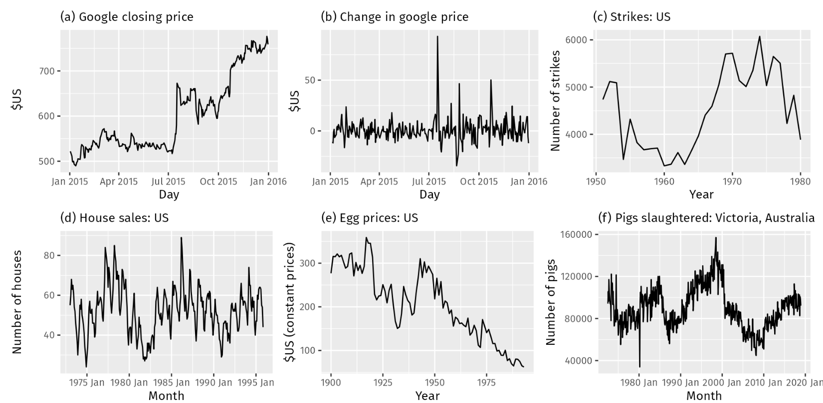
Which series are stationary?
https://otexts.com/fpp3/stationarity.html

Slide 26
Testing for stationarity
Augmented Dickey-Fuller (ADF) test
  $H_{0}$ = there is a unit root ($φ=1$) => non-stationary
  $H_{1}$ = there is no unit root => stationary
  Example:
  > adf.test(y)
  Dickey-Fuller = -2.66, Lag order = 7, p-value = 0.3068
  alternative hypothesis: stationary
The more negative, the stronger the evidence againt H0 -> i.e. that the series is stationary
<0.05 : reject H0 -> no unit root -> stationary

Slide 27
Making a series stationary
Options
  Transformation (e.g. log): when variance increases
  Differencing ($Δy_{t}=y_{t}−y_{t−1}$) : to stabilise mean
  Seasonal differencing ($Δ_{12}y_{t}=y_{t}−y_{t−12}$)
  Detrending (regression against time, then use residuals)
Sometimes not easy to see if process is stationary:
$y_{t}=y_{t−1}+ε_{t}$ (non-stationary) vs.
$y_{t}=0.95y_{t−1}+ε_{t}$ (stationary)
in practice hard to distinguish for finite time series
$→$ unit root test

Slide 28
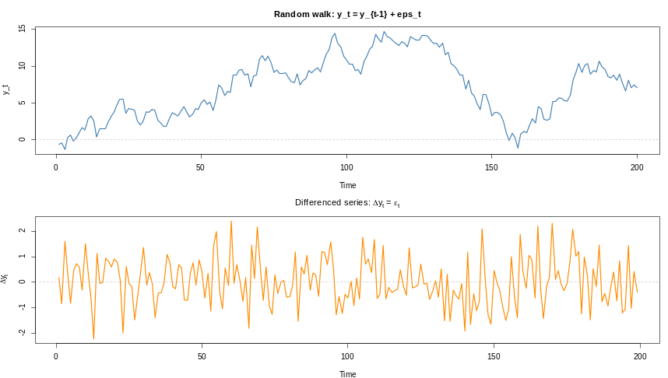
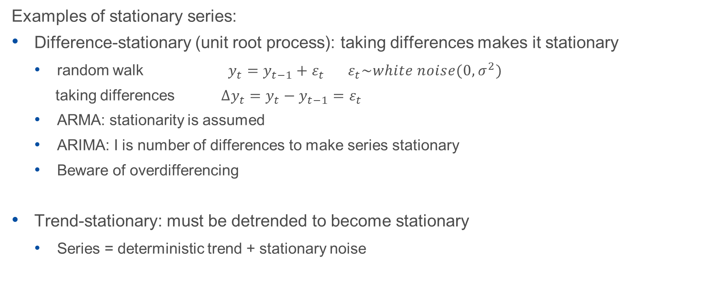
Making a series stationary
Examples of stationary series:
Difference-stationary (unit root process): taking differences makes it stationary
  random walk $y_{t}=y_{t−1}+ε_{t} ε_{t}\sim white noise(0,σ^{2})$
  taking differences ${Δy}_{t}=y_{t}−y_{t−1}=ε_{t}$
  ARMA: stationarity is assumed
  ARIMA: I is number of differences to make series stationary
  Beware of overdifferencing
Trend-stationary: must be detrended to become stationary
  Series = deterministic trend + stationary noise

Slide 29
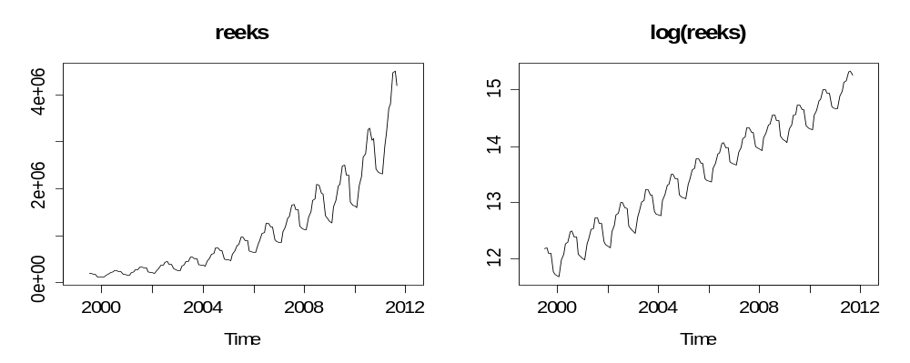
Transformations
series log(series)
To stabilise variance (i.e. homoscedasticity)
To make data more normally distributed
To make data more linear (make multiplicative seasonal additive)
  E.g., take Log
  But : makes model more difficult to interpret

Slide 30
Autocorrelations

Slide 31
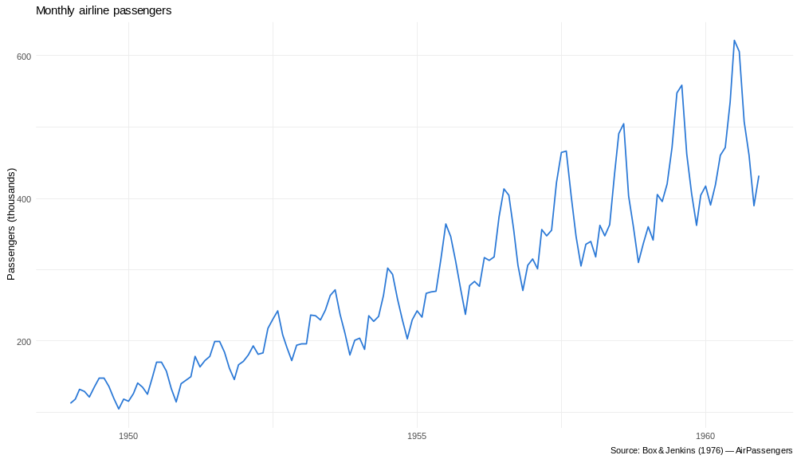
Autocorrelations

Slide 32
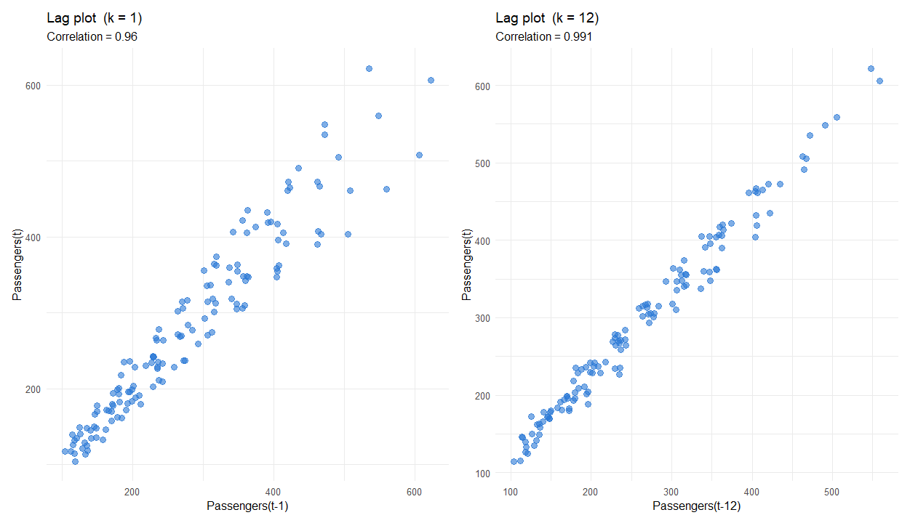

Slide 33
ACF and PACF
ACF: autocorrelation function
Corr$\left[y_{t},y_{t−k}\right]$
PACF: partial autocorrelation function
  if $y_{t}$and $y_{t−1}$ are correlated, then also $y_{t−1}$and $y_{t−2}$
  Then also $y_{t}$and $y_{t−2}$ via $y_{t−1}$
  PACF removes indirect correlations
$$acf= ρ(k)=\frac{\sum_{t=1}^{T−k}{(y_{t}−\overline{y})(y_{t+k}−\overline{y})}}{\sum_{t=1}^{T}{{(y_{t}−\overline{y})}^{2}}}$$

Slide 34
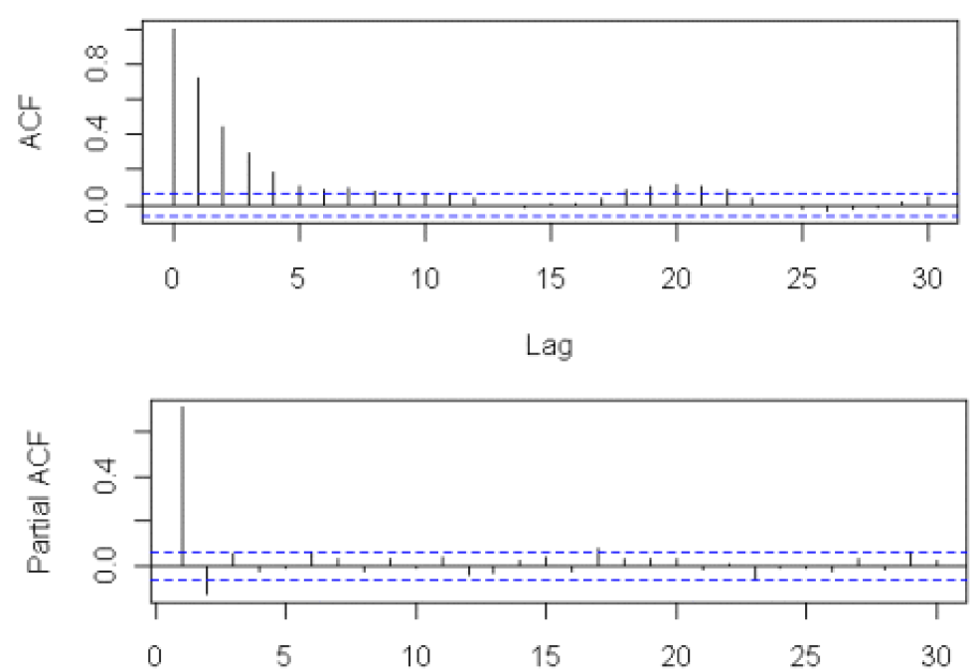
Correlogram

Slide 35
ARMA order selection using ACF and PACF
AR(p):
ACF exponentially decaying or sinusoidal
PACF not significant after lag p
MA(q):
ACF not significant after lag q
PACF exponentially decaying or sinusoidal

Slide 36
ARIMA models

Slide 37
ARIMA-models
ARIMA : describes autocorrelations: variable is correlated with past values of itself
STM : describes trend and seasonal
Autoregressive model: linear combination of past values (‘lags’), past determines the present
  E.g.:
  y_{t} = y_{t-1} + error
  y_{t} = ½ y_{t-1} + ½ y_{t-2} + ε_{t}
  y_{t} = y_{t-12} + ε_{t}

Slide 38
ARIMA-models
Box and Jenkins (1970)
ARIMA = AR + I + MA
Special cases:
  Random walk
  Exponential smoothing
Overlap with State space models

Slide 39
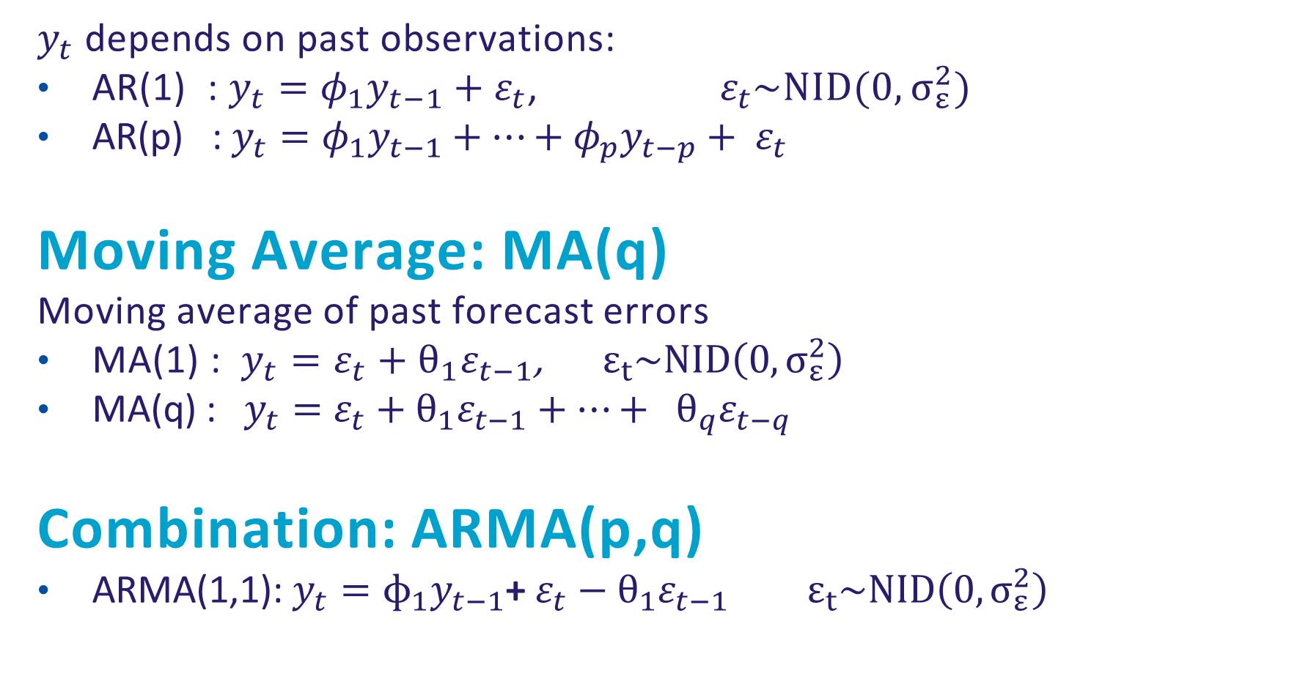
Autoregressive: AR(p)
$y_{t}$ depends on past observations:
AR(1) : $y_{t}={φ_{1}y}_{t−1}+ε_{t}$, $ε_{t}\sim NID(0,σ_{ε}^{2})$
AR(p) :$y_{t}={φ_{1}y}_{t−1}+…+{φ_{p}y}_{t−p}+ ε_{t}$
Moving Average: MA(q)
Moving average of past forecast errors
MA(1) : $y_{t}=ε_{t}+θ_{1}ε_{t−1}$, $ε_{t}\sim NID\left(0,σ_{ε}^{2}\right)$
MA(q) : $y_{t}=ε_{t}+θ_{1}ε_{t−1}+…+ {θ_{q}ε_{t−q}}_{}$
Combination: ARMA(p,q)
ARMA(1,1): $y_{t}=ɸ_{1}y_{t−1}$+ $ε_{t}−θ_{1}ε_{t−1}$ $ε_{t}\sim NID\left(0,σ_{ε}^{2}\right)$

Slide 40
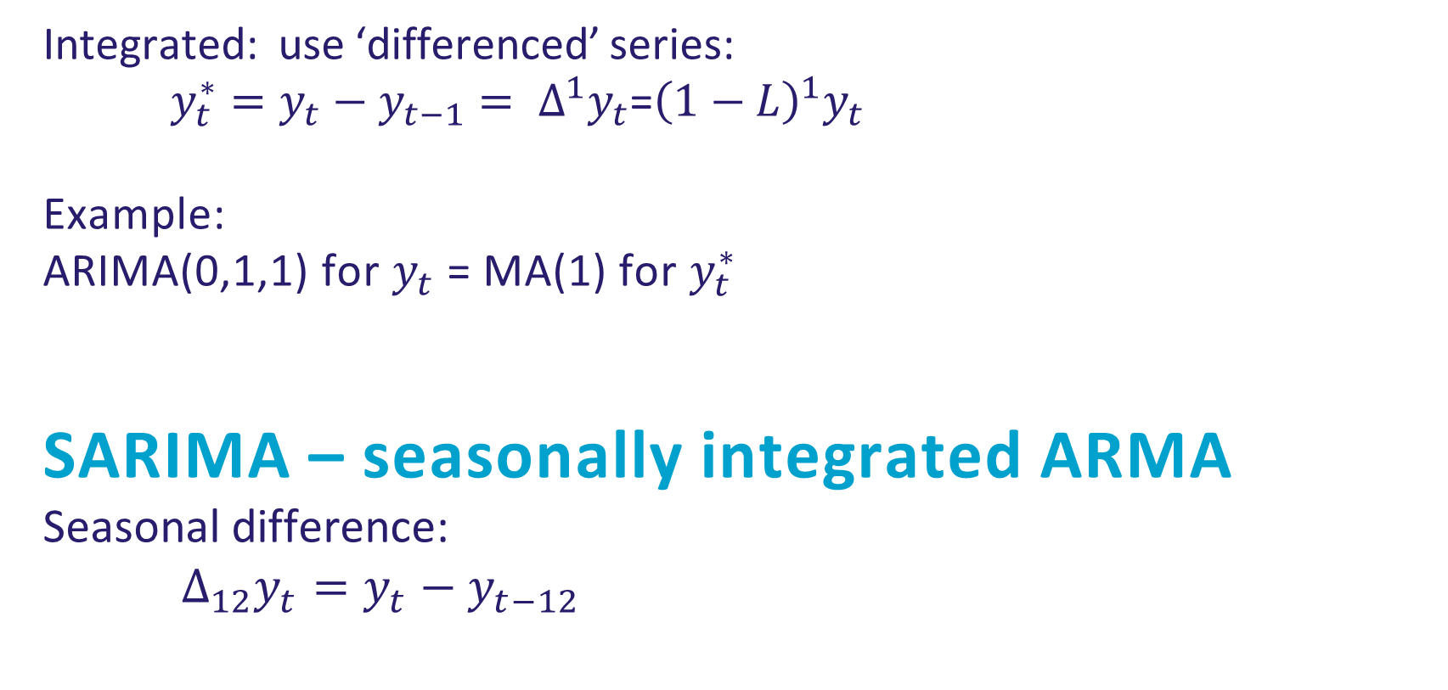
I - Integrated
Integrated: use ‘differenced’ series:
$y_{t}^{∗}=y_{t}−y_{t−1}= ∆^{1}y_{t}$=${\left(1−L\right)}^{1}y_{t}$
Example:
ARIMA(0,1,1) for $y_{t}$ = MA(1) for $y_{t}^{∗}$
SARIMA – seasonally integrated ARMA
Seasonal difference:
$Δ_{12}y_{t}=y_{t}−y_{t−12}$

Slide 41
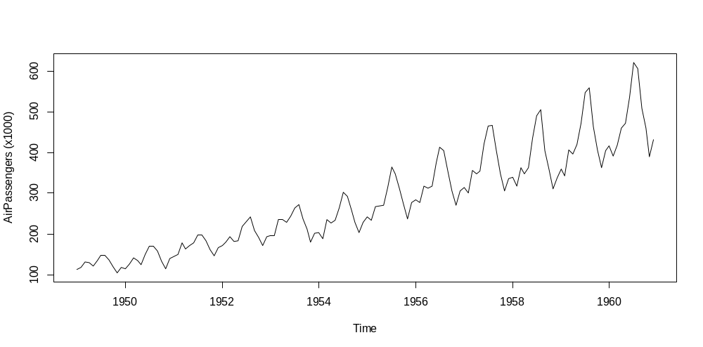
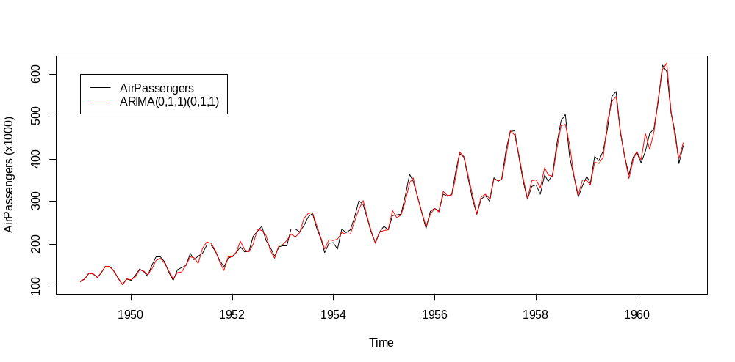
Airline model (Box and Jenkins)
Log(y_{t}): (0,1,1)(0,1,1)₁₂

Slide 42
Relations between series

Slide 43
Relations between time series
Do they move together simultaneously?
Does one influence the other (with a delay)?
Do they share a common trend?
We will look at:
Correlation
Cointegration
Leading/lagging series
  Cross-correlation
  Causality

Slide 44
Correlation
Measures the extent to which two series move at same time
  Measure of linear dependence, $r_{xy} ε [−1,1]$
$$r_{xy}=\frac{\sum_{t=1}^{T}{(x_{t}−\overline{x})(y_{t}−\overline{y})}}{\sqrt{\sum_{t=1}^{T}{{(x_{t}−\overline{x})}^{2}}}\sqrt{\sum_{t=1}^{T}{{(y_{t}−\overline{y})}^{2}}}}$$

Slide 45
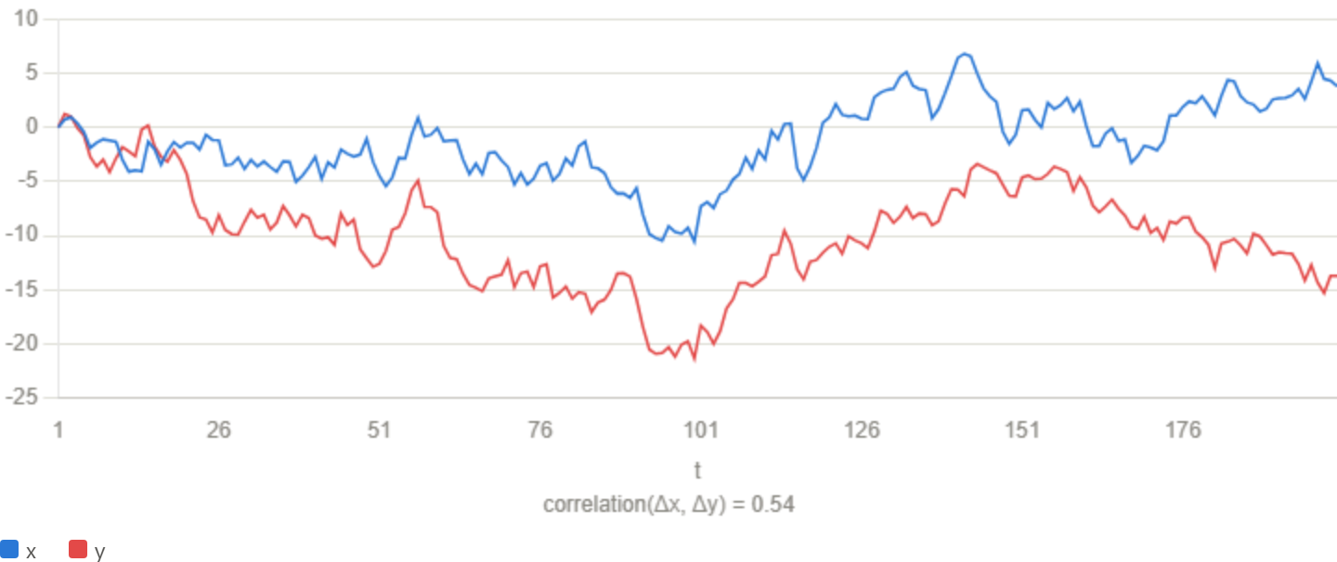
Correlation
  Do their changes coincide?
  Does not say anything about the long-term relation between their levels
  Example: stock prices: same changes but levels may move in opposite direction

Slide 46
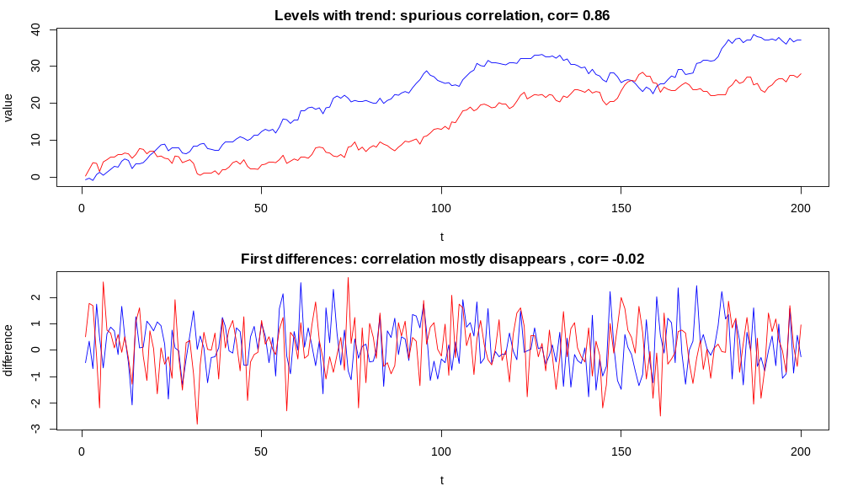
Correlation
Problem with correlation: can be misleading for nonstationary series
  Risk of spurious correlation* (statistical relation that has no meaningful/causal relation), caused by:
    By chance (e.g. small sample size)
    Nonstationarity, (e.g. a shared trend), > differencing / detrending
    A third confounding factor (e.g. a seasonal or macro-economic factor): e.g. coffee consumption and electricity production (both trend up because of GDP and population growth) or ice cream consumption and drownings (both high in summer)
* Granger & Newbold (1974)

Slide 47
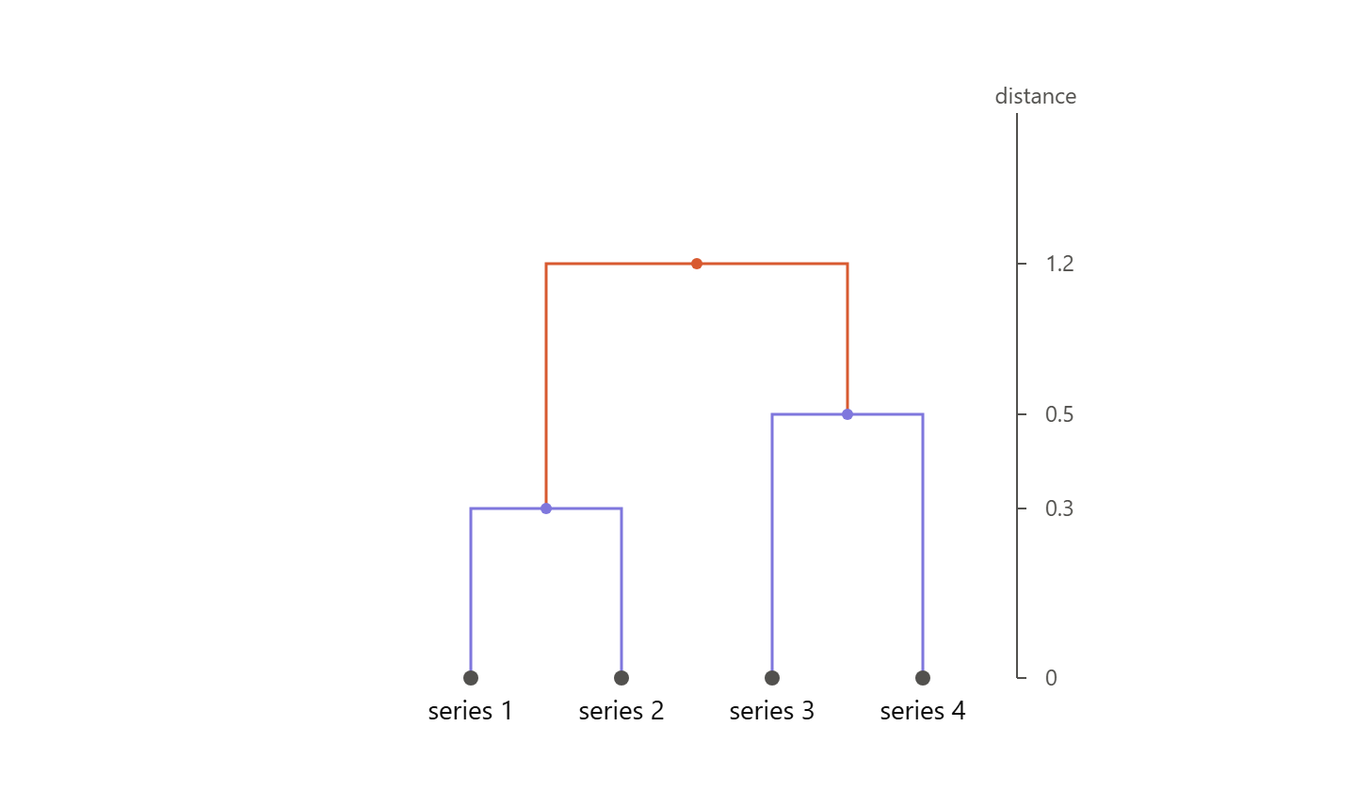
Time series clustering
Do they move together?: hierarchical clustering based on correlation matrix
Steps:
  Normalise / standardise all series (to avoid scale/amplitude influencing the clustering)
  Hierarchical clustering:
    Start with each time series as a separate cluster
    Combine two nearest clusters based on distance
    Compute new distance matrix
    Repeat until there is one cluster
    Choose # clusters

Slide 48
Cointegration

Slide 49

Cointegration
Describes a long-run equilibrium relationship among two or more time series variables
Two series are cointegrated if there exists a linear combination that is stationary
The series themselves may be non-stationary
If $x_{t}$ and $y_{t}$ both have integration order $d=1$, then a linear combination of them must be stationary for some value of $β$ and $u_{t}:$
  ${y_{t}−βx}_{t}=u_{t}$, where $u_{t}$ is stationary, i.e. $u_{t}\sim I(0)$ (integrated of order 0)
E.g. ‘drunken man and his dog’ (both random walk)

Slide 50
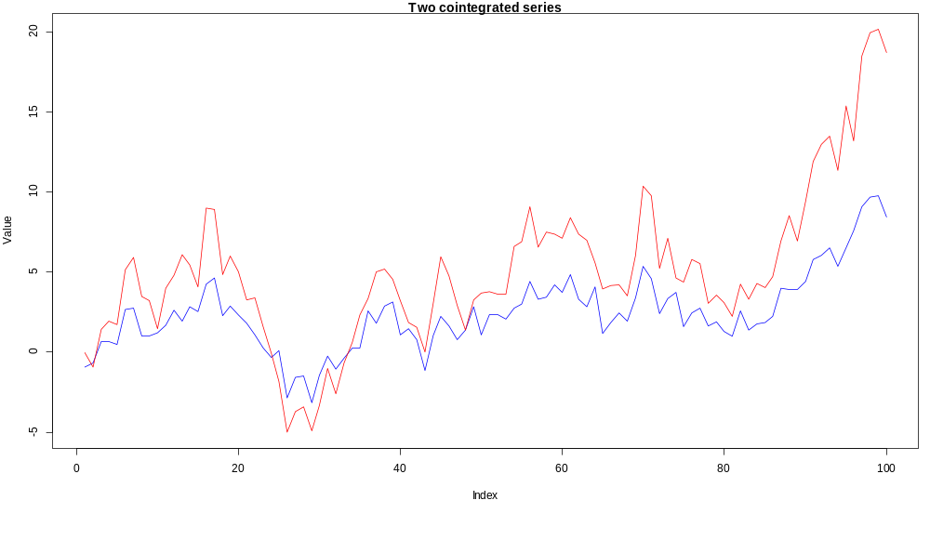
Cointegration - example

Slide 51
Identifying cointegrated series
Engle-Granger test for cointegration (1987)
Estimate $β$ via OLS
$$y_{t}=α+ βx+ u_{t}$$
Test $u_{t}$for stationarity with ADF-test
model <- lm(y ~ x)
adf.test(residuals(model))
Note: test is assymetrical. Outcome depends on choice dependent variable, and can lead to different outcome in some cases. To be sure, do in both directions.

Slide 52
Correlation and/or cointegration
Series can be correlated, but not cointegrated
  E.g. two stock prices can be highly correlated in their daily returns, without being cointegrated (prices levels drifting apart)
  GDP of developed and developing country may have different trends, but their quarterly growth rates may be highly correlated.
Series can be cointegrated, but with small correlation
  Income $y_{t}$and consumption $c_{t}$
  Consumers adapt their spending to their income
  Both are I(1), but the consumption quote ${log⁡(c}_{t})−{log⁡(y}_{t})$ should be stationary
  > see Exercise

Slide 53
Temporal relations

Slide 54
Temporal relations
Leading indicator has predictive value for another indicator
Coincident indicator: moves at same time
Lagging indicator: moves with a certain delay
E.g. unemployment (lags wrt economic cycle)
E.g interest rate (leading wrt recession)

Slide 55
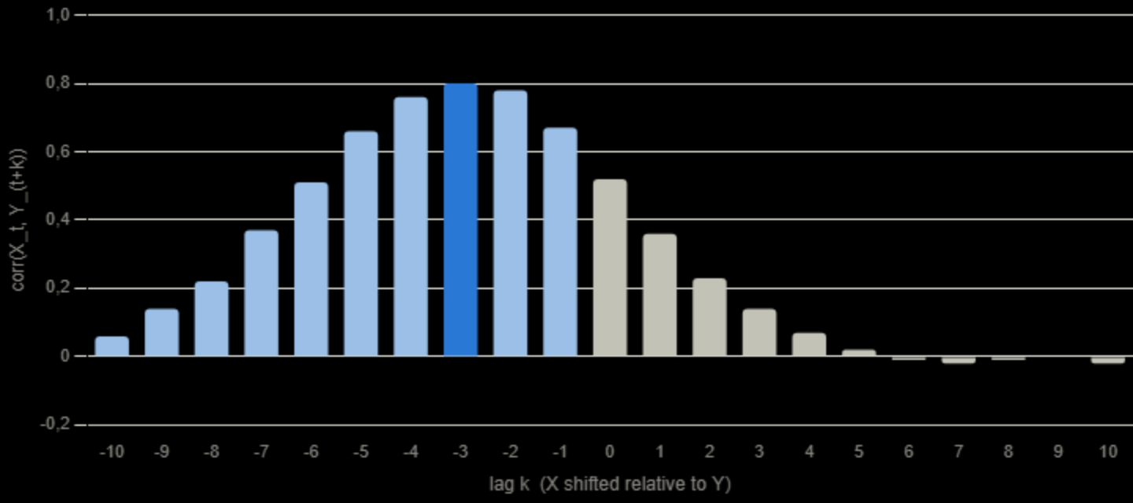
Temporal relations
Cross-correlation function (ccf)
  Correlation between two (weakly) stationary time series $x_{t}$ and $y_{t}$ at lag $k$ is:
  Again: beware of spurious correlations, so test for stationarity and take e.g. differenced series
  E.g. $x_{t}$ leads $y_{t}$:
$${ccf=r}_{xy}(k)=\frac{\sum_{t=1}^{T−k}{(x_{t}−\overline{x})(y_{t+k}−\overline{y})}}{\sqrt{\sum_{t=1}^{T}{{(x_{t}−\overline{x})}^{2}}}\sqrt{\sum_{t=1}^{T}{{(y_{t}−\overline{y})}^{2}}}}$$

Slide 56
Temporal relations
Granger-causality test:
  Test to determine if past values of $x_{t}$ help to predict $y_{t}$ (additional to predictive power of $y_{t}$’s own history)
  Statistical causality, not real causality.
  Test is based on a Vector-autoregressive model (VAR) model
  With non-stationary series, standard errors and p-values are not valid -> first test for stationarity

Slide 57
Granger Causality
Step 1: restricted model - predict y only from its own lags
  $y_{t}=α+β_{1}y_{t−1}+β_{2}y_{t−2}+…+β_{p}y_{t−p}+ε_{t}$
Step 2: unrestricted model - add lagged values of x:
  $y_{t}=α+β_{1}y_{t−1}+β_{2}y_{t−2}+…+β_{p}y_{t−p}+γ_{1}x_{t−1}+…+γ_{p}x_{t−p}+ε_{t}$
Step 3: F-test
  Compare the residual sum of squares (RSS) of both models
  $H_{0}$ is $γ_{1}=γ_{2}=…=γ_{p}=0$, i.e. the $x$-terms do not contribute anything
  If adding $x$-terms significantly lowers the RSS (F-test large enough, p-value small), we reject $H_{0}$ and say $x$ Granger-causes $y$.

Slide 58
Summary
Do they move together simultaneously? -> correlation
  Their changes are related
  Does not say anything about long term relation between their levels
Do they share a common trend? -> cointegration
  Series may move randomly but they do not drift apart
  Individual series are non-stationary, there is a linear combination that is stationary
Does one influence the other with a delay? -> CCF / Granger causality

